Slide 1


Prototype Submission Phase

Slide 2
TEAM NAME and MEMBER DETAILS
Team Members
Stream
Year
Team Leader
1
Aditi Anand Kulkarni
C.S
IV
Team Member
C.S
II
2
Devavrat Dhaygude
IV
Samarth Shendre
C.S
III
3
IV
4
Saee Bandal
C.S
III
IV
C.S
II
5
Vaidehi Borikar
IV
THEME:
C.E
II
Predictive Maintenance for Smart Factories using NIM
Develop a system that predicts potential machine failures based on sensor data, thereby enabling proactive maintenance. This reduces downtime, optimizes energy usage, and extends machinery lifespan.

Slide 3
PROBLEM STATEMENT
Unplanned machine downtime is a critical issue affecting multiple manufacturing operations, leading to significant negative impacts.
It can cause:
Disruption in Production: When machines fail unexpectedly, the production line halts, causing delays that ripple through the entire supply chain. This leads to missed deadlines, reduced output, and lost opportunities. The downtime may also force companies to rely on alternative, less efficient processes to meet production targets, further straining resources and reducing productivity.
Increased Operational Costs: Unforeseen breakdowns often result in high maintenance and repair costs, as immediate fixes may require emergency services, expedited shipping for replacement parts, or the use of expensive temporary solutions. Additionally, companies may need to compensate for lost production time with overtime labor, increased energy consumption, or the rental of backup equipment, all of which drive up operating expenses.
Reduced Efficiency and Performance: Frequent and unplanned downtimes disrupt manufacturing operations by reducing throughput and causing suboptimal equipment performance after repairs. These interruptions accelerate wear and tear on machinery, shortening its lifespan and increasing the likelihood of further breakdowns. This cycle of inefficiency negatively impacts long-term productivity.

Slide 4

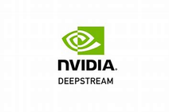

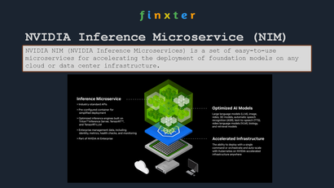
SOLUTION
We propose a real-time predictive maintenance system using NVIDIA Inference Microservices (NIM) and Generative AI models to tackle unexpected equipment failures and inefficient maintenance in smart factories.
NVIDIA Inference Microservices (NIM) enables continuous monitoring of machine health through rapid real-time data analysis.
Generative AI models predict equipment failures, detect anomalies, and optimize maintenance schedules, enabling proactive interventions and reducing downtime, while improving operational efficiency.
Some impact metrics :
Reduction in Unplanned Downtime
Maintenance Cost Savings
Improvement in Machine Lifespan
Accuracy of Failure Predictions
Return on Investment (ROI)
Impact on Safety and Compliance
Technologies Stacks to be Used
NVIDIA Inference Microservices (NIM)
Triton Inference Server
DeepStream
TensorRT
NVIDIA Fleet Command
NVIDIA Metropolis
NVIDIA AI Enterprise
How It Helps Solve the Problem:
Prevents unplanned
Increases machine lifespan
Optimizes energy consumption
Effectiveness and Scalability:
High Predictive Accuracy
Scalable Architecture
Adaptability
Implementation Ease:
Integration with Existing Systems
Modular Architecture
User-Friendly Tools

Slide 5
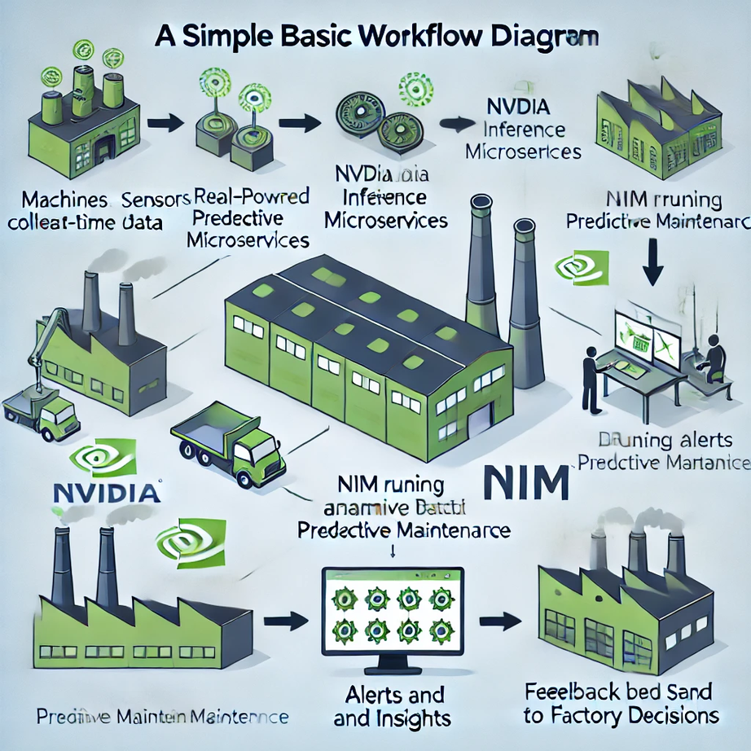
METHODOLOGY
1.⁠ ⁠Data Collection
- Gather operational data from machinery sensors (e.g., temperature, speed, torque).
2.⁠ ⁠Data Preprocessing
- Clean and preprocess data for consistency.
- Encode categorical variables (e.g., type and failure).
3.⁠ ⁠Model Development
- Select machine learning algorithms (selected algorithm - decision tree).
- Train and evaluate models using metrics like accuracy and F1 score.
4.⁠ ⁠Integration with NVIDIA Inference Microservices
- Deploy trained models using NIM for real-time predictions.
5.⁠ ⁠Flask Backend Development
- Create RESTful API endpoints for input data and predictions.
6.⁠ ⁠Chatbot Implementation
-Develop a chatbot for user interaction using llama-3.1-405b-instruct
7.⁠ ⁠Testing and Validation
- Perform unit and integration testing to ensure system reliability.

Slide 6
WORKING PROTOTYPE

Slide 7
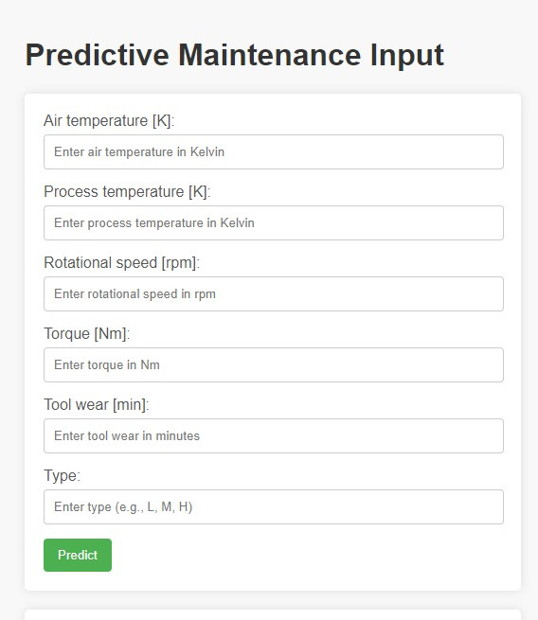
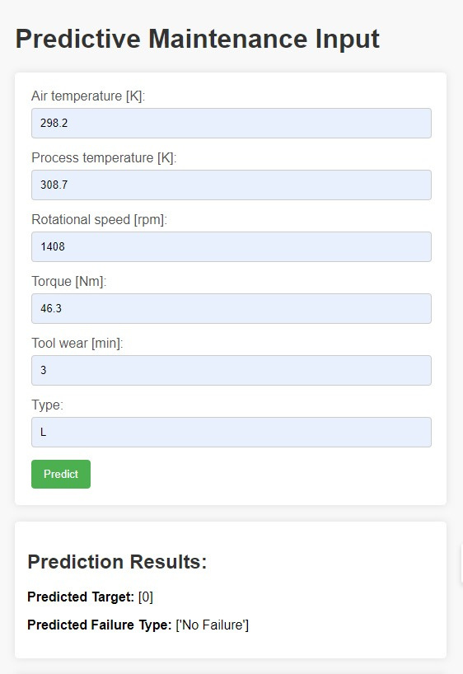
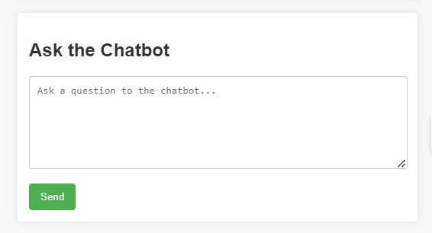
Attachments

